Slide 1
DBØ – LEADERSHIP TRAINING PROGRAM
STRENGTHEN YOUR PERSONAL LEADERSHIP SKILLS

Slide 2
STRENGTHEN YOUR PERSONAL LEADERSHIP SKILLS
Background
Good management and leadership in the construction industry takes collaborative skills, good communication skills and the ability to motivate others.
In this leadership program focus is on the leaders' own personal skills and the ability to create good relationships.
The program focuses on strengthening the most important tool the leader has got: themselves!
You can not lead others without being able to lead yourself.
Takeaways from the program:
During the program you will be introduced to leadership tools, that will help you:
To create trust, motivation and commitment
To gain insight into your personal strengths and weaknesses in the leadership role
To ensure your emotional robustness in a turbulent business
To ensure good management of conflicts
To create good change processes
To design good process of decision making for you and your team

Slide 3
Outline of the leadership training program
The participants in the leadership training program work with their own personal challenges in the leadership role.
We believe that traditional learning must be supported by a personal focus in the implementation. Throughout the entire program the theoretical perspectives presented will be related to the challenges of the participants' in their own organization.
There are professionals from different branches of the construction industry participating in the program, which give rise to good discussions and common reflections on the challenges of the building industry.
The Leadership training program consists of 4 session of 2 days + 1 day of examination. Total of 9 days.
Session 1 is a 2 day session on a conference center close to Copenhagen.
Participant are expected to prepare themselves between modules. 1-2 hours per module.
A personality test is used on 2 of the 4 modules. Each module are described in more detail on the following pages.

Slide 4
Session 1 Effective communication and personal impact
In this first session the participants will get an opportunity to professionalize their ability to present and communicate in front of an audience on this intensive 2-day training camp.
The first module is intended to be a kickoff-session for the entire development process, where energy and good relationships are created in the participant group, and the participants can train and provide feedback on communication skills.
Why is this theme relevant to managers?
Communication is the key to succeeding as a leader. An increased awareness by the leader of his/her own personal style of communication and insight into his/her own strengths and weaknesses in communication, can strengthen the leaders personal impact in relations to both employees and stakeholders.
Key takeaways:
Techniques and tools for use in public speaking
Training in using body language, intonation and location in the room to enhance the experience of authority and build rapport with your audience
Concrete tools for structuring presentations, so that they are customized to the target audience
Insights in your own strengths in terms of personal communication and impact.
Theoretical knowledge based on modern brain research on perception, attention and memory
Duration: 2 day. Internat.

Slide 5
Session 2 Neuroleadership and the art af making good decisions
Neuroleadership focuses on applying neuroscience to leadership development, management training, change management education and consulting, and coaching.
For the past ten years, researchers have become far more aware of how the human brain works and what it implies for our performance, interaction and well-being. A better understanding of the brain and knowledge about how our people function both cognitively and emotionally will improve participants’ leadership skills in relation to:
Decision making and problem solving
Keep calm under pressure
Collaboration with others
Understand the emotional reactions of others in times of change
Key takeaways: The participants will get a better understanding of the brain and more knowledge about how we human beings work - both cognitively and emotionally - when making decisions. The brain science has revealed that we are not as logical and rational individuals as we might think. Common sense is strongly overrated. There is focus on:
The brain's fast and slow system – system 1 and 2 (Daniel Kahnemann)
How do managers and employees make the right decisions? What are the most common pitfalls?
When can we trust our gut feelings and when are automatic reactions unhelpful and lead to systematic bad decisions?
How can this knowledge be helpful in creating optimal decision-making processes in teams? Duration: 2 days.

Slide 6
Session 3
Building a succesful team
Being able to create good and meaningful relationships is the whole foundation for being able to successfully work in - and especially to lead - project teams in the construction industry.
This session introduces a unique development tool for relationships and reaction patterns, based on the recognized Strength Deployment Inventory (SDI) tool.
The SDI approach involves helping people understand how their motives drive their behaviors, how those motives and behaviors change during different situations, and how to develop a better understanding of the motive-driven behaviors of others. It’s an approach that drives stronger relationships and more effective teams.
Key takeaways:
Participants become more aware of their own choice of behavior and more conscious in their understanding of the behavior of others.
The SDI tools are designed to help people understand themselves and others – not just how we behave, but why we behave in certain ways – and that understanding can lead to meaningful, practical changes in leaders and teams that minimize conflict and maximize effectiveness.
People are Complex; Relationships Don’t Have to Be
Duration: 2 days

Slide 7
Session 4
The emotionally intelligent leader
What is emotional intelligence and why is it important? Simply put it is how to read the environment and act accordingly.
Much of our work success is based on our skills, knowledge and experience; but another part depends on how we get on with colleagues, managers, staff who report to us, suppliers and customers. We need to understand ourselves and how we appear to other people, as well as understand what makes other people tick.
Emotional intelligence is important in work areas as varied as leadership and management, team and project work and all types of customer relationships.
People leave managers, not companies. Emotionally intelligent managers have high self-awareness, are excellent communicators and can adapt their natural leadership style to suit a variety of situations. As a result, their teams tend to be well motivated and have high morale, which contributes to retaining staff.
Key takeaways:
Feedback on your level of Emotional Intelligence
Personal Assesment T-EIQ by Thomas International
Duration 2 days

Slide 8
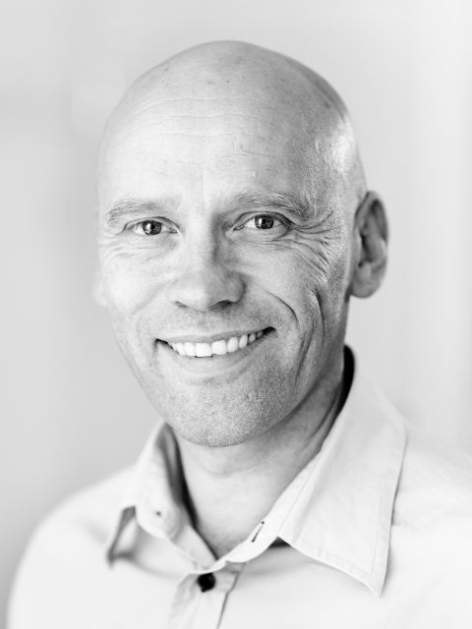
Instructor HENRIK SKOVDAL
Organisationskonsulent - Skovdal Consulting
Henrik Skovdal has worked as an organization and management consultant since 2001 and has extensive knowledge of the construction industry. Henrik Skovdal has worked for teams and organizations in both Norway and Denmark.
Henrik Skovdal is a humorous and passionate teacher who is able to convey complicated material in an entertaining and inspiring way.
Read more here:
www.skovdalconsulting.dk
www.linkedin.com/in/henrikskovdal
Contact info:
h.skovdal@icloud.com eller mobil 20 16 69 77

